Slide 1
The Effect of Palmar Hyperhidrosis to Smartphone Usage in Metro Manila
CORONEL, Sherine Jane
LLANTOS, Joneil Thom
JIMENEZ, Marc Adrian
Notes:
5% of the worlds population (367 million people) has hyperhidrosis.

Slide 2
Smartphone use to Palmar Hyperhidrosis-Affected People
WHY?
Smartphones Today
Excessive Sweating
Customer Complaints
Thomas & friends
Notes:
Smartphones today
define smartphones (handheld, compact)
innovation
features
-> water resistance
Excessive Sweating
hyperhidrosis (5% of the worlds population -> 367 million) accdg to International Hyperhidrosis Society
palmar hyperhidrosis definition
effects on the individual
Customer Complaints
(cont. of effects on individuals)
complaining why their smartphones doesn’t work well when wet
along with the existence of waterproof/resistant smartphones in the market

Slide 3
Smartphone use to Palmar Hyperhidrosis-Affected People
To Answer
Advantages and Disadvantages
How would they solve it?
Scope and Limitation
Thomas & friends
Notes:
Research Questions
1. What are the advantages and disadvantages of having palmar hyperhidrosis when using a smartphone that has touch-sensitive display and fingerprint authentication?
2. How can smartphone developers solve the issues pointed out by their consumers with Palmar Hyperhidrosis?
Scope and Limitation

Slide 4
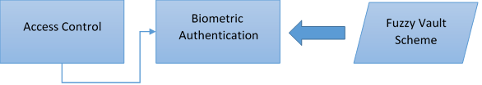
Thomas & friends
Notes:
FOR CF
ACCESS Control – Limiting access to a certain place or resource (main purpose -> security)
Biometric Authentication – A form of access control wherein physiological characteristics are used such as iris scanning, fingerprint, dna, face, etc.
Fuzzy Vault Scheme – an encryption scheme, stating that an encoded item can only be decoded if the input has huge resemblance with the originally encoded item.

Slide 5
Methodologies
Nature of the Study
Population and Sample
Research Instruments
Gathering Procedures
Thomas & friends
Notes:
Nature of the Study
goal-oriented research
* representation – how factors affect a certain phenomenon
*** where factor = palmar hyperhidrosis
*** where phenomenon = smartphone usage
Population and Sample
snowball sampling (referral sampling)
live in manila with smartphone
Research Instruments
2 Questionnaires (UX & Diagnosis)
Semi-Structured Interview
Iodine-Starch test
Gathering Procedures
provide two questionnaires (diagnosis and UX)
- fraction would be chosen to do the iodine-starch along with the semi-structured interiew
Data Analysis

Slide 6
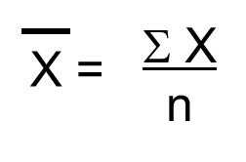
DATA ANALYSIS
Mean
Where X = individual data
N = number of response
Thomas & friends
Notes:
To quantify and average the dataset by grouping them based on their conditions severity

Slide 7
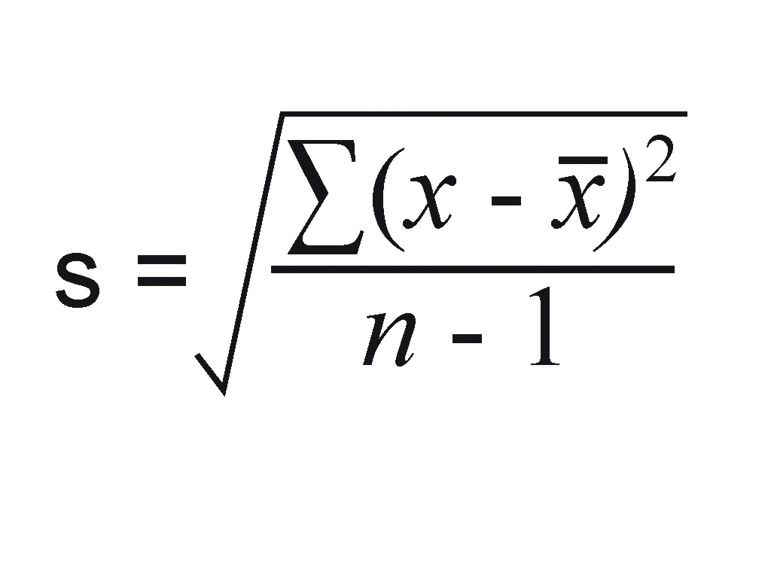

DATA ANALYSIS
Standard Deviation
Where X = individual data
$\overline{X}$ = mean
N = number of responses
Thomas & friends

Slide 8
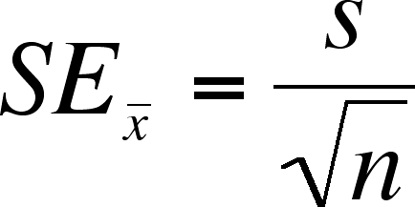
DATA ANALYSIS
Standard Error of the Mean
Where S = standard deviation
N = number of responses
Thomas & friends
Notes:
Just for data accuracy

